Slide 1
Do you like to be smarter than you are?
If No, then you are in wrong crowd today.
If yes, then Let me introduce to you Mr. Android, who will help you get smarter.
Introducing SmartPhone Application Development Using Android Development Environment.
Nov 29, 2012
Fairfield University
By
Fahim Uddin.
email@fahim.cooperativecorner.com
http://fahim.cooperativecorner.com
203-543-9688

Slide 2
Who am I?
My name happens to be Fahim Uddin. You don’t like it, blame my parents. ☺
Website – http://fahim.cooperativecorner.com
Email – email@fahim.cooperativecorner.com
Graduated : in 2004 from UB with EE Degree
Working in IT for City Govt: Since 2007
.NET Developer: From 2005 to 2007
Student: PhD in progress.

Slide 3
First of All
I need to know you. Your Prog background and mind.
This PPT has lot of information and we will pick the relevant as time allows today.
Upon Request, I can send you the following
This PPT file
PDF guide to setup your machines
A quick Hello Android Tutorial to get you started.
Some Great Articles to read as you fasten your seat belt to take ride for Android-Land.

Slide 4
Let’s face the truth
I am not highly experienced nor supreme guru for Android Development. At-least not yet ☺
I myself is on the road to learn and have not taken an exit yet ☺
I have not taught this course yet except some guest lectures.
But I yet have to offer that you will like.
I have extreme potential to learn through self study and teaching and open discussion and very open to learn from those who I teach.
The economy today is not like it used to be rather very tough and lets accept that we have to bring some change to the ways we teach and learn to be able to achieve our goals in our careers effectively.
English is not first language so if you have trouble understanding, please let me know.
I have developed the unique style of teaching this course to make it extremely effective and interactive and our goal is to nail down Android Development but Nothing else and ofcourse to be able to make some bucks down the road.
Together, we will make this course a very interactive and practical based on current market trends and future vision in mind
Any ideas ??????????????????????????????????????????????????

Slide 5
What does this PPT contain?
General Introduction to Open Source and Motivation to learn.
Introduction to Linux and Android.
Introduction to Java Basics.
Resource information to learn Java and Android
Few Basics of code example to warm up Java skills.
Sample Code for Android
Understanding Android Architecture
Understanding Android Programming code example.
Understanding various components in Android Programming.
Android Emulator Vs Real Device Discussion.
Android Course Anatomy and Teaching and learning style throughout the semester for full 3 credit course.
etc

Slide 6
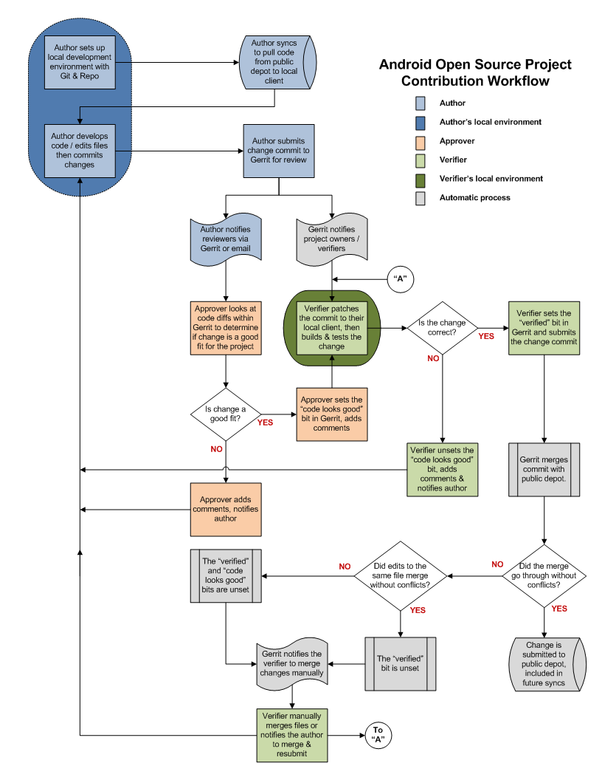
AOSP workflow
http://source.android.com/source/life-of-a-patch.html

Slide 7
This Course is about using Open Source Programming tool.
Lets pay little respect to OSP.
http://opensource.org/
http://www.oemr.org/
http://www.x12.org/
http://sourceforge.net/
http://www.ohloh.org/
http://flossmole.org/
http://flosshub.org/
http://openworldforum.org
http://freshmeat.net
http://osdir.com
http://developer.berlios.de
http://bioinformatics.org
I told you all these site. What is the question here that you should be asking me??
Also What is Open Source anyways?

Slide 8
OS
Software programs are written or developed in a language which can be understood by humans. This is called a programming language and it is the source code of the program. This source code is then normally translate or compiled into binary code which can be understood and run by a computer. Normally when buying a license to a software product, for instance a game or MS Windows, you are normally only paying for the right to run the program. You are commonly not given the right to study, redistribute and improve the program and you are not given the source code.
The advantage of OSS is that you are given the right to study, improve and redistribute the software which means that you can further extend any piece of OSS if you have the skills to do so. This gives a lot of flexibility and this flexibility is great! Both for people who like to work with programming but also for normal software users because they can chose where they get their support. Furthermore, OSS come without licensing fees. This does not necessarily mean that using OSS is for free and it does not mean that companies cannot make money on OSS. However, you as a user do at least not have to pay any license fees.
http://www.oyvindhauge.com/blog/2008/06/30/

Slide 9
How to make money of OS
Well, if you are a developer of your product and you know inside and outside of it, that makes you a Great resource to support it, right?
Bill Robinson, VP of the Americas for Alfresco Software (news, site) says being a commercial company behind an open source project, "gives us the ability to deliver enterprise standard service level agreements — a must for companies and organizations deploying enterprise content management solutions.“
Commercial "Enterprise" Upgrades

Slide 10
What else can you do?
1. Sell Support Contracts
2. Sell Value-Added Enhancements
3. Sell Documentation
4. Sell Binaries
5. Sell Your Expertise as a Consultant

Slide 11
http://opensource.about.com/
Businesses who make money in open source software include:
MySQL (now owned by Oracle): Popular relational database.
Red Hat: Major distributor of Linux for server and desktop use.
WordPress: Widely used blogging platform.
SugarCRM: Business customer relations management.
Magento: E-commerce shopping platform.
Zimbra: E-mail and messaging server.

Slide 12
Android Course Anatomy
Most likely we will use my own book that I tried written in unique style based on my study from various resources and books and real world exercises and bug fixing.
OR – We will follow my power points for open discussion and code and handouts will be given in class accordingly.
We will, most likely, develop one big Project. Call it Project Android 2013. That will consist of 5 assignments that we will do together as we move along.
You and I both will help develop this project so don’t leave me alone in the middle of desert.
Mid term and Final term.
We will not exit this course unless we make sure each and every one of us have learned what we said, we will learn.

Slide 13
Careers in Android or OS
http://www.onwardsearch.com/Android-Development-Jobs/careers/
http://jobs.monster.com/v-it-q-android-developer-jobs.aspx - will surprise you.
http://www.indeed.com/q-Android-jobs.html
http://www.freelancer.com/jobs/Android/

Slide 14
What You need to know?
Nothing – only kidding.
At minimum, you need to have mindset to learn and program to develop apps.
Lot of patience.
Ability to read documentation and APIs.
OOP experience or at minimum some programming experience or knowhow.
Java exp will really help.
If you have nothing that I just mentioned then Good bye – only kidding.
By the way, Why do you think they created DMV (Driving Motor…….)???

Slide 15
Hardware and Software Req
Windows Machine or Mac Machine.
JDK
ADK
Eclipse
Android plugin.
By the way, how much do you think it will cost you to get all those software???

Slide 16
How to get those softwares?
I let you figure this out, even though I could tell you.
OK- here is one of these
Download Eclipse from http://www.eclipse.org
So let’s be clear, Your Assignment # 0.1 is setup your machines. This assignment will weight 90 % of your grades –hehehehe- You wish!!!

Slide 17
Let’s see what are those all software pieces about.
Android SDK – You would need that to use the APIs written for Android development.
Java SDK – you would need this to be able to write this in java code.
Eclipse – You don’t need this if you don’t want to use this. However, this is highly recommended and known IDE to develop and test, debug your code.
ADT toolkit – so Eclipse knows that you like to develop for Android and it allows you to do so with help of it and more.

Slide 18
Best Advice to get started
Try to run few basic Java programs and use your OOP concepts (C++ and .NET langs, etc)
Download JDK on your machines
Download IDE to make your life easy
Start writing
Best documentation is from Oracle – who owns Java (not you ☺ )

Slide 19
What Should Students Already Know?
Java!
  inheritance, method overriding
  interfaces, casting
  exceptions
  debugging
  reading API documentation
Eclipse
  easy to pick up quickly, though

Slide 20
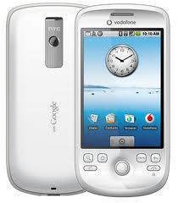
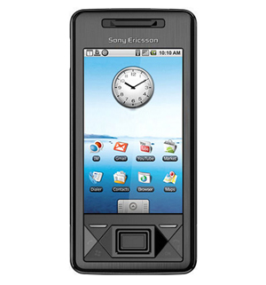
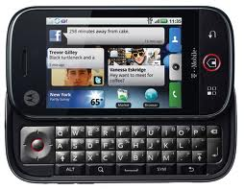
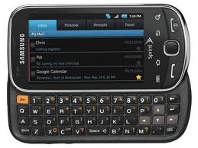
Do I Need Phones?
The emulator that is part of the Android toolset for Eclipse is quite good (though a bit slow)
You may be able to get free “developer phones” from Google

Slide 21
Online Resources
developer.android.com
code.google.com/p/apps-for-android/
stackoverflow.com
videos from Google I/O conferences

Slide 22
1. Set Up Your Android Environment
http://developer.android.com/sdk
Install Eclipse
Install Android SDK (Android libraries)
Install ADT plugin (Android development tools)
Create AVD (Android virtual device)

Slide 23
Free Vs Open Source Software
Open source is a development methodology; free software is a social movement.
http://opensource.org/docs/osd
http://www.gnu.org/philosophy/free-sw.html
A program is free software if the program's users have the four essential freedoms:
The freedom to run the program, for any purpose (freedom 0).
The freedom to study how the program works, and change it so it does your computing as you wish (freedom 1). Access to the source code is a precondition for this.
The freedom to redistribute copies so you can help your neighbor (freedom 2).
The freedom to distribute copies of your modified versions to others (freedom 3). By doing this you can give the whole community a chance to benefit from your changes. Access to the source code is a precondition for this.

Slide 24
http://c2.com/cgi/wiki?FreeSoftwareVsOpenSource
There is an ideological difference between the proponents of the terms "Free Software" and "Open Source".
The term FreeSoftware was introduced in the early 1980's by the movement we now know as the FreeSoftwareFoundation. RichardStallman and others wanted to avoid the potential MoralDilemma? of either denying his neighbour a copy (of software and/or source code), or breaking either copyright or NonDisclosureAgreement. To achive this goal he started the GnuProject, and a definition for FreeSoftware was crafted. Thus, the definition of FreeSoftware is focused on the freedom to share with your neighbor.
The term OpenSource was later introduced by another community including ESR, is more or less indifferent to moral issues concerning software sharing. The OpenSource movement argues that developing software using the "bazaar" philosophy (as described in TheCathedralAndTheBazaar) is superior. Hence the definition of OpenSource is focused on effective development using the bazaar model.
While both discuss software whose users are permitted certain freedoms with respect to the code, OpenSource tends to focus on providing an economic/business argument for FreeSoftware. FreeSoftware focuses on providing a moral/ethical argument for OpenSource. The distinction is between "using/providing FreeSoftware is a good, morally right, thing to do" and "using/providing OpenSource Software is beneficial to you and your business".
In most cases OpenSource software is also FreeSoftware, so the difference is mostly that the OpenSource community, probably in order to be more BusinessFriendly?, refuses to subscribe to the ethics of the FSF. The GnuProject's homepage has a page to track their opinion about different kind of software licenses:
http://www.gnu.org/philosophy/categories.html

Slide 25
Why Android Use Java? Why not just use native coding.
Java is a known language, developers know it and don't have to learn it
It runs in a VM, so no need to recompile it for every phone out there and easy to secure
Large number of development tools for java (see first)
Several mobile phones already used java me, so java was known in the industry
Android runs on many different hardware platforms.
You would need to compile and optimize your native code for each of these different platforms to see any real benefits. –
There are a large number of developers already proficient in Java. –
Java has huge open source support, with many libraries and tools available to make developers life easier. –
Java protects you from many of the problems inherent in native code, like memory leaks, bad pointer usage, etc. –
Java allows them to create sandbox applications, and create a better security model so that one bad app can't take down your entire OS.

Slide 26
Why Android runs on JVM?-myth
Android doesn't run on a Java virtual machine. That's why Oracle is suing them. Sun/Oracle would have liked Google to license a Java VM for large amounts of money. Instead, Google implemented their own virtual machine called Dalvik. It's not compatible with Java, it's not even the same architecture as Java, being a register machine rather than stack-based. The Android SDK includes a translator which takes Java VM bytecode, and translates it to Dalvik bytecode.
As to why Android runs on a VM, there are a number of reasons.
Firstly, it makes it easier to sandbox and control the apps for security reasons.
Secondly, it makes the apps more compact. Native ARM code is RISC, with all the instructions being the same length, and hence takes up comparatively large amounts of space.
Thirdly, it gives them the option of migrating to different CPU hardware without needing developers to rebuild every single application.

Slide 27
JVM vs DVM
Conceptually, there is little difference from an application level between a DVM and a JVM.
Architecturally, there is a major difference between the register based DVM and the stack-based JVM.
Both use a VM code model.
However, the DVM uses register based opcodes that are comparable to the register-based bytecode instructions that most of the target platforms already execute. This includes architectures such as those available from ARM and MIPS and the x86-compatible architectures from Intel, AMD, and VIA Technologies.
Google developed Android and chose DVM for several reasons.
First, there were licensing issues with most JVMs.
Next, the DVM should be more efficient in terms of memory usage and performance on a register-based machine.
DVM is also supposed to be more efficient when running multiple instances of the DVM. Applications are given their own instance. Hence, multiple active applications require multiple DVM instances. Like most Java implementations, the DVM has an automatic garbage collector.
DVM is Register based which is designed to run on low memory, uses its own byte code and runs .Dex file
JVM is Stack based which uses java byte code and runs .class file having JIT.
Java source code is compiled by the Java compiler into .class files. Then the dx (dexer) tool, part of the Android SDK processes the .class files into a file format called DEX that contains Dalvik bytecode. The dx tool eliminate all the redundant information that is present in the classes. In DEX all the classes of the application are packed into one file. DVM has been designed so that a device can run multiple instances of the VM efficiently.
http://sawankumar46.blogspot.com/2012/03/dvm-vs-jvm.html

Slide 28
Quick discussion about Java
Java is an object-oriented language, with a syntax similar to C
  Structured around objects and methods
  A method is an action or something you do with the object
Avoid those overly complicated features of C++:
  Operator overloading, pointer, templates, friend class, etc.

Slide 29
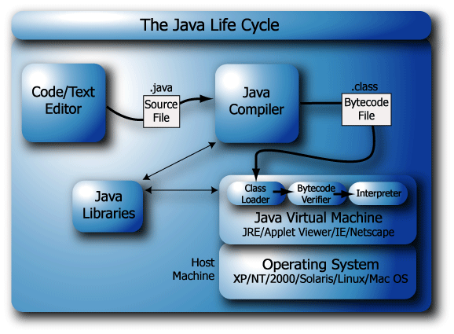
Java programs exist in the form of compiled bytecode, that is similar to machine code, except that the platform target is the Java Virtual Machine (JVM). A JVM resides within every Java compatible WWW browser and indeed stand-alone with the Java Run-time Environment (JRE).
http://elm.eeng.dcu.ie/~ee402/ee402notes/html/ch04s02.html

Slide 30
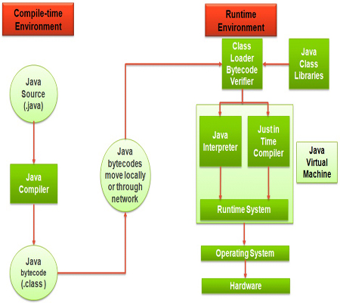
http://educatesquare.com/tutorials/java-tutorial/core-java-basics/

Slide 31
Java Sample Hello World Example
/* Our first Java program – HelloWorld.java */
public class HelloDaddy {
//main()
public static void main ( String[] args ) {
System.out.println( ”Hello Daddy!" );
}
}
CAN YOU FIND THE error?

Slide 32
The three principles of OOP
Encapsulation
  Objects hide their functions (methods) and data (instance variables)
Inheritance
  Each subclass inherits all variables of its superclass
Polymorphism
  Interface same despite different data types
car
Super class
manual
auto-
matic
Subclasses
draw()
draw()

Slide 33
Classes
Fundamental unit of Java program
All java programs are classes
A class is a template or blueprint for objects
A class describes a set of objects that have identical characteristics (data elements) and behaviors (methods).
  Existing classes provided by JRE
  User defined classes
Each class defines a set of fields (variables), methods or other classes

Slide 34
Quick Example of Class Person
Person Fahim; //declaration
//only created the reference, not an object. It points to nothing now (null).
Fahim = new Person();//create an object of Person
//create the object (allocate storage in memory), and Fahim is initialized.
Fahim.name= “Fahim Uddin”;//access its field
//access the object through the reference
Person Tom = new Person();
Tom.name=“Tom Jackson”;
Fahim.printInfo(); // call method
Tom.printInfo();

Slide 35
In Essence, I want you to
Understand Object and It’s Usage
Classes
What differentiate an OOP from Non-OOP?
Can you write a program that looks like a OOP but it is not?
Memory management and usage.
Rest, you figure out.

Slide 36
JRE and JVM
A JVM is, in effect, a bytecode interpreting machine running on a hardware machine. This interpreting stage has an overhead and slows the program execution performance of Java applications.
Java bytecode is extremely compact, allowing it to be easily delivered over a network.
In theory, the JVM in each Web browser is built to the same specification, requiring that one version of source code should be compatible with many platforms, provided that a Java enabled Web browser exists for that platform.
In reality, not all Web browsers implement the exact same JVM specification, introducing minor inconsistencies when the same Java applet is viewed using several different browsers, on different platforms.

Slide 37
Continued
We can use any text editor to create the high-level Java text file. This file is saved as a .java file on the disk. We then compile this text file using the Java compiler, which result in a .class file being created on the disk. The .class file contains the bytecodes. The file is then loaded into memory by the class loader. The bytecode verifier confirms that the bytecodes are valid and not hostile. Finally, the JVM reads the bytecodes in memory and translates them into machine code.
The Java Runtime Environment (JRE) is what you get when you download Java software. The JRE consists of the Java Virtual Machine (JVM), Java platform core classes, and supporting Java platform libraries. The JRE is the runtime portion of Java software, which is all you need to run it in your Web browser.

Slide 38
JDK (Java Development Kit)
Java Developer Kit contains tools needed to develop the Java programs, and JRE to run the programs. The tools include compiler (javac.exe), Java application launcher (java.exe), Appletviewer, etc…
Compiler converts java code into byte code. Java application launcher opens a JRE, loads the class, and invokes its main method.
You need JDK, if at all you want to write your own programs, and to compile the m. For running java programs, JRE is sufficient.
JRE is targeted for execution of Java files
i.e. JRE = JVM + Java Packages Classes(like util, math, lang, awt,swing etc)+runtime libraries.
JDK is mainly targeted for java development. I.e. You can create a Java file (with the help of Java packages), compile a Java file and run a java file
JRE (Java Runtime Environment)
Java Runtime Environment contains JVM, class libraries, and other supporting files. It does not contain any development tools such as compiler, debugger, etc. Actually JVM runs the program, and it uses the class libraries, and other supporting files provided in JRE. If you want to run any java program, you need to have JRE installed in the system
The Java Virtual Machine provides a platform-independent way of executing code; programmers can concentrate on writing software, without having to be concerned with how or where it will run.
If u just want to run applets (ex: Online Yahoo games or puzzles), JRE needs to be installed on the machine.
http://www.javabeat.net/
http://www.java.com

Slide 39
Why JVM is called virtual?

Slide 40
Answer
The JVM is called "virtual" because it provides a machine interface that does not depend on the underlying operating system and machine hardware architecture. This independence from hardware and operating system is a cornerstone of the write-once run-anywhere value of Java programs.
There are different JVM implementations are there. These may differ in things like performance, reliability, speed, etc. These implementations will differ in those areas where Java specification doesn’t mention how to implement the features, like how the garbage collection process works is JVM dependent, Java spec doesn’t define any specific way to do this.

Slide 41
Andy Rubin, (who is he?):
We have an SDK we give to developers, and when we write our Gmail app, we use the same SDK. A lot of guys have private APIs. We don’t. That’s on policy and on technology. If there’s a secret API to hook into billing system we open up that billing system to third parties. If there’s a secret API to allow application multitasking, we open it up. There are no secret APIs. That is important to highlight for Android sake. Open is open and we live by our own implementations.

Slide 42
Answer
Andrew E. Rubin is the co-founder and former CEO of both Danger Inc., and Android Inc. He is currently Senior Vice President of Mobile and Digital Content at Google, where he oversees development of Android, an open-source operating system for smartphones.^{[1][2]} Rubin has four patents for his inventions.

Slide 43
What is API
Definition
Why Is It Needed?
What Is It Really?
Application Programming Interface

Slide 44
The word to really pay attention to is “Interface”. If you have any experience at all with programming, all kinds of abstractions and contracts must be coming to your mind when you hear the word “interface” but we are more interested in the classical meaning of the term.
An interface is a common boundary between two separate systems. It is the means or the medium via which these two systems communicate.
Definition
An API is the interface implemented by an application which allows other applications to communicate with it.
Why Is It Needed?
In one word – communication. You might ask why communication is so important. Just imagine Notepad couldn’t copy-paste to and from Microsoft Word or Google Chrome. Imagine having to type each and every time although the text is already there in some other application. This is only one of the examples of communication between applications and all this communication is made possible via APIs.
What Is It Really?
You cannot run an API like you would run say a Notepad application. This is because APIs are generally invisible to the end users like you and me. APIs are carefully thought out pieces of code created by programmers for their applications that allow other applications to interact with their application.

Slide 45
Java limitation
Java does not support multiple inheritance.
In other words, Java can not have more than one parent.
Single inheritance language.
Answer is: ???

Slide 46
Interface is the answer
Available through C++ or another c based language.
Interface is like a contract with a class to include certain methods and it basically up to us how we implement those but we have to include those methods.

Slide 47
Interface?
Definition: An interface is a collection of method definitions (without implementations) and constant values.
You use interfaces to define a protocol of behavior that can be implemented by any class anywhere in the class hierarchy. Thus a better approach to the spreadsheet cell problem would be to create an interface, say CellAble, that defined the list of methods that a "cell value" must implement: toString(), draw(), toFloat(), and so on. Then the spreadsheet cells could contain any type of object that implemented the CellAble interface (or in other words implemented the list of methods). Objects that implemented the CellAble interface would not have to be hierarchically related.

Slide 48
Interfaces are useful for:
capturing similarities between unrelated classes without forcing a class relationship
declaring methods that one or more classes are expected to implement
revealing an object's programming interface without revealing its class (objects such as these are called anonymous objects and can be useful when shipping a package of classes to other developers)
In Java, an interface is a reference data type and, as such, can be used in many of the same places where a type can be used (such as in method arguments and variable declarations). You'll see how to do this in Using an Interface as a Type.
Interfaces Do Not Provide Multiple Inheritance
Often interfaces are touted as an alternative to multiple class inheritance. While interfaces may solve some of the same problems as multiple class inheritance, they are quite different animals. In particular:
you cannot inherit variables from an interface
you cannot inherit method implementations from an interface.
the interface hierarchy is independent of a the class hierarchy--classes that implement the same interface may or may not be related through the class hierarchy. This is not true for multiple inheritance.

Slide 49
Reference vs. primitive
Java handle objects and arrays always by reference.
  classes and arrays are known as reference types.
  Class and array are composite type, don’t have standard size
Java always handle values of the primitive types directly
  Primitive types have standard size, can be stored in a fixed amount of memory
Because of how the primitive types and objects are handles, they behave different in two areas: copy value and compare for equality

Slide 50
Copy
Primitive types get copied directly by =
  int x= 10; int y=x;
Objects and arrays just copy the reference, still only one copy of the object existing.
FAHIM
Name: FAHIM
height: 0
weight: 0
Person FAHIM = new Person();
FAHIM.name=”FAHIM";
Person x=FAHIM;
x.name=“TOM";
System.out.println(FAHIM.name); // print TOM!
x

Slide 51
Scoping: in a class
public class VisibilityDemo {
private int classVar1;
private int classVar2;
public int method1(int x) {
int local = 0;
for (int i = 0; i < x; i++){
local += i;
}
return local;
}
public void method2 ( int x) {
classVar1 = x + 10;
classVar2 = method1(classVar2);
}
}
The red identifiers denote class varialbes and methods. They have visibility anywhere inside the outermost pair of red curly brackets
The blue identifiers are local to a single block (identified by blue brackets). They are not visible to anything outside of their block, but are visible inside blocks nested inside of the blue bracketed block.
The gray identifiers are found inside the for-loop. The gray variable i is visible only inside the loop.
Parameters are denoted by green. They are visible everywhere inside the method in which they appear, but only in that method

Slide 52
Access control
Access to packages
  Java offers no control mechanisms for packages.
  If you can find and read the package you can access it
Access to classes
  All top level classes in package P are accessible anywhere in P
  All public top-level classes in P are accessible anywhere
Access to class members (in class C in package P)
  Public: accessible anywhere C is accessible
  Protected: accessible in P and to any of C’s subclasses
  Private: only accessible within class C
  Package: only accessible in P (the default)

Slide 53
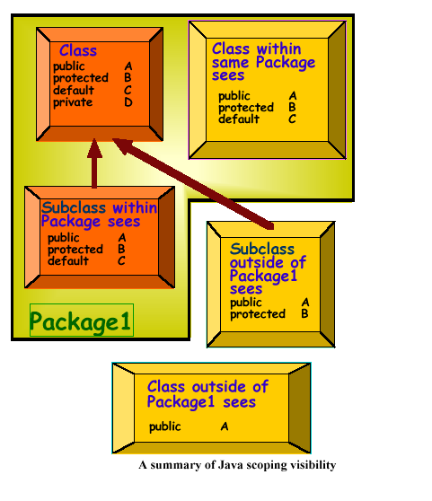
Scoping: visibility between classes

Slide 54
The static keyword
Java methods and variables can be declared static
These exist independent of any object
This means that a Class’s
  static methods can be called even if no objects of that class have been created and
  static data is “shared” by all instances

Slide 55
XML
eXtensible Markup Language
Simple text (Unicode) underneath
Tags (like in HTML) are used to provide information about the data
Similar to HTML, but:
  HTML is used to describe how to display the data
  XML is used to describe what is the data
Often used to store and transfer data

Slide 56
HTML Example
<html>
<head><title>Here goes the title</title></head.
<body>
<h1>This is a header</h1>
Here goes the text of the page
</body>
</html>
Tags mean something specific to the browser
They are used for display

Slide 57
XML Example
<?xml version=“1.0”/>
<person>
<name>
<first>Fahim</first>
<last>Uddin</last>
</name>
<email>muddin@bridgeport.edu</email>
<phone 203-000-0000 />
</person>
Tags mean whatever the user wants them to mean
They are used to describe the data

Slide 58
XML Rules
Tags are enclosed in angle brackets.
Tags come in pairs with start-tags and end-tags.
Tags must be properly nested.
  <name><email>…</name></email> is not allowed.
  <name><email>…</email><name> is.
Tags that do not have end-tags must be terminated by a ‘/’.
Document has a single root element

Slide 59
XML Documents are Trees
person
email
phone
name
first
last

Slide 60
Bored Already? I know.
Lets get into our real business.
SmartPhone App Development.
Lets get start coding in Android - ☺ Not yet kids.
Let me remind, you are going to code for a very different devices in nature that you are not used to. Yes, I know you have done 15 years of App development for Windows and Web. That may help but lets talk about few imp things when It comes to SmartPhone Devices.

Slide 61
Who invented first smartphone?
????

Slide 62
Answer
The first ever smartphone was designed by IBM in 1992. Their first smartphone was called 'SIMON'. Besides being a simple phone, it also contained a calendar, address book, world clock, calculator, note pad, e-mail, send and receive fax, and games which are basic features of mobile phones today

Slide 63
SmartPhone
Is a relatively small physical device.
Which means, limited hardware, memory, processor, speed, space, loyalty ☺
You need all these challenges in mind when you code.
Lot of competition as compared when you used to code for Intel based devices.
Now you have to make sure you app behaves on limited resources much better as it was running as web app on smartphone.
For example. www.facebook.com Vs Facebook app.
You got the idea…☺

Slide 64
SmartPhone Industry Introduction
Apple Inc (a U.S Corp)
Research in Motion – RIM – Canadian Corp
HTC Corporation (A Taiwanes Corp)
Motorola, Inc ( a US Corp)
Samsung Electronics Co. Ltd. (Korean)
HP/Palm (US)
LG corp (Korean)
Nokia Corp

Slide 65
Back to Business – Mr. Android
Sorry we are little late but not too late ☺
What is Android:
It was originally developed by Android Inc. Google purchased it in 2005. Today it is being developed by OHA(Open Handset Alliance) led by Google and other companies.
OHA – a consortium of about 86 hardware, software and telecommunication companies who are devoted to promoting and advancing Open Standard for mobile devices. Google has releases Android code as Open Source under the Apache License. This License simply means: go ahead and download the source code (SDK) and develop it for free. Vendors and hardware manufacturer can extend android into their own versions to distinguish their products and devices.

Slide 66
Pick any definition that you like
Android is simply a mobile operating system. It is actually modified version of Linux OS.
The first truly open and comprehensive platform for mobile devices, all of the software to run a mobile phone but without the proprietary obstacles that have hindered mobile innovation. (http://googleblog.blogspot.com/2007/11/wheres-my-gphone.html)
It is an open source mobile operating system that combines and builds on different parts of various open source projects. This makes it platform independent development tool.
It is simply another OOP framework that helps building mobile devices environment that is running supported OS in conjunction. For example, the application that you develop using Android can run on any phone or tablet device that is running any of Google’s OS versions (will discuss this later) and it does not matter who is manufacturer of device, unlike Apple App Development that requires Apple Device with iOS running as Operating System.
If you come up with your own definition of Android after your hands are wet enough with experience of development with Android, then please write that in lines below:

Slide 67
Android is an open source operating system, created by Google specifically for use on mobile devices (cell phones and tablets)
Linux based (2.6 kernel)
Can be programmed in C/C++ but most app development is done in Java (Java access to C Libraries via JNI (Java Native Interface))
Supports Bluetooth, Wi-Fi, and 3G and 4G networking

Slide 68
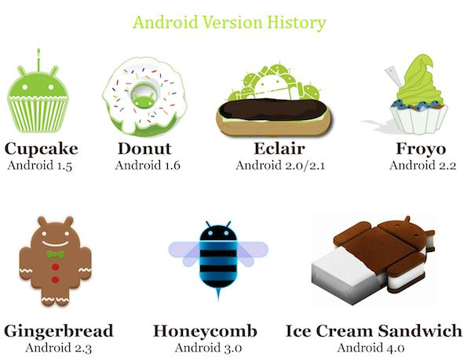
From its Birth
On 30 April 2009, the official 1.5 (Cupcake) update for Android was released.
On 15 September 2009, the 1.6 (Donut) SDK was released.
On 26 October 2009 the 2.0 (Eclair) SDK was released
On 3 December 2009 the 2.0.1 SDK was released.
On 12 January 2010 the 2.1 SDK was released.
Rest you figure out yourself.
http://www.droidedition.com/

Slide 69
What is Web App
A mobile web app is a web application formatted for smartphones and tablets, and accessed through the mobile device’s web browser. Like a traditional web application, a mobile web app is built with three core technologies: HTML (defines static text and images), CSS (defines style and presentation), and JavaScript (defines interactions and animations). Since web apps are browser-based, they’re intended to be platform and device independent, able to run on any web-enabled smartphone or tablet. A mobile web app is normally downloaded from a central web server each time it is run, although apps built using HTML5 (described below) can also run on the mobile device for offline use.

Slide 70
Mobile Web Apps vs. Mobile Native Apps:
I love Mobile Apps because
The key advantage of mobile web apps over native mobile apps is cross-platform compatibility , allowing them to reach the broadest audience for the least effort.
++Web apps are also cheaper and easier to maintain than native apps for the same reasons, using cross-platform applets rather than keeping up with changes across different devices.
++Simple, ubiquitous access: Users don’t have to download an application, but simply access a URL via their mobile browser which instantly delivers the most up-to-date application to their device. They can then bookmark the URL for repeat use.
I don’t like them because
Disadvantages:
++Although improvements are ongoing, mobile browsers have limited capabilities compared to traditional desktop browsers. Functionality is similar for the major players (Apple, Android, RIM, Windows), but falls off sharply on other platforms. Depending on what platforms need to be supported, the solution may be limited to the lowest common denominator, giving the app a “clunky” look, or require time-consuming customization across browser versions.
++Web apps generally1 cannot access the on-board hardware and software on a mobile device. Requirements such as camera control, direct GPS control (there is limited access to current location), PIM integration, or control of the phone app will rule out web apps right away. Heavy/complex custom graphics (gaming, etc.) also cannot be supported.
++Web apps generally require a connection to function, with performance issues if the website is slow or unavailable. When users are on the go without Wi-Fi coverage, they have to pay for connection time to network operators. In some countries the cost is minimal, but in others can be a showstopper. (This changes with HTML5, which makes web app content available in offline mode so users can still access the app even if they do not have cell reception or connection to a Wi-Fi network.)

Slide 71
I love mobile native apps because
++A richer, more compelling user experience: Native apps can leverage the capabilities of the mobile device, including onboard hardware (such as GPS, camera, and graphics) and software (such as email, calendar, contacts, picture/ video gallery, file manager, and home screen widget areas).
++Ability to run offline: Since the application remains installed on the device from the original download, no internet connection is required. Users get peak performance at all times, with all graphics, images, scripts and data. Data transfers can resume (and re-sync with back end apps) when the connection is restored.
++Better “front of mind” penetration: Native apps place a logo in the application list screen, providing visibility on a daily basis. In addition, app stores remind users to upgrade apps, so apps that update frequently (with real improvements) are more frequently brought to the user’s attention.
++Native apps are “hot” right now. Users are continually combing app stores for the latest app they can’t live without, giving products there a higher likelihood of being discovered.
++Native apps are also easier to monetize. You set a price, list the app on an app store, and when users buy it, you make money immediately (minus the commission). With a web app, you would have to set up a payment or subscription gateway if monetizing the app is something you want to do.
I don’t like them because
++Content publishers have to share information about their subscribers with the app store, an arrangement that frustrates publishers (particularly media companies).
++For a native app to work across multiple devices, separate versions of the app are required. The fragmented nature of the mobile industry means that developing, testing, and porting apps for different environments costs money—particularly with maintenance and promotion costs. Cross-platform frameworks can make things easier, but time and cost remain a fact of life when developing for rich functionality on multiple mobile platforms. (The next section explores development issues for mobile apps in more detail.)
++Keeping the application up to date also means more work for the enterprise, requiring development, testing, and distribution for different platforms rather then simply updating a single website.

Slide 72
Hybrid Apps
I don’t want to tell you anything today about it.
I want you to do some research about it.
If we ever meet again, we will exchange information.

Slide 73
OS for Smartphones
Pro-pri-e-tary (Proprietary)
Licensable
Open Source
Smartphone manufacturers will generally choose OS Model based on their core strengths.
Pro – are developed in house.
Apple, RIM, HP/Palm take this approach.
What is advantage of Pro.
Licensable OS allow any manufacturer to use the OS for a device they produce.
Largely used as is with a manufacturer’s unique hardware (sometime customization is possible).
Why Smartphone manufacturer will choose this?
Open Source why?

Slide 74
ilunx??
What is it?

Slide 75
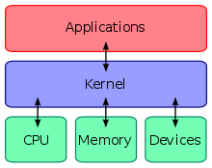
Kernel
The technical definition is "platform that consists of specific set of libraries and infrastructure for applications to be built upon and interact with each other". A kernel is an operating system in that sense.
The end-user definition is usually something around "a software package that provides a desktop, shortcuts to applications, a web browser and a media player". A kernel doesn't match that definition.
So for an end-user a Linux distribution (say Ubuntu) is an Operating System while for a programmer the Linux kernel itself is a perfectly valid OS depending on what you're trying to achieve. For instance embedded systems are mostly just kernel with very small number of specialized processes running on top of them. In that case the kernel itself becomes the OS itself.
I think you can draw the line at what the majority of the applications running on top of that OS do require. If most of them require only kernel, the kernel is the OS, if most of them require X Window System running, then your OS becomes X + kernel.
In computing, the kernel is the main component of most computer operating systems; it is a bridge between applications and the actual data processing done at the hardware level. The kernel's responsibilities include managing the system's resources (the communication between hardware and software components).[1] Usually as a basic component of an operating system, a kernel can provide the lowest-level abstraction layer for the resources (especially processors and I/O devices) that application software must control to perform its function. It typically makes these facilities available to application processes through inter-process communication mechanisms and system calls.

Slide 76
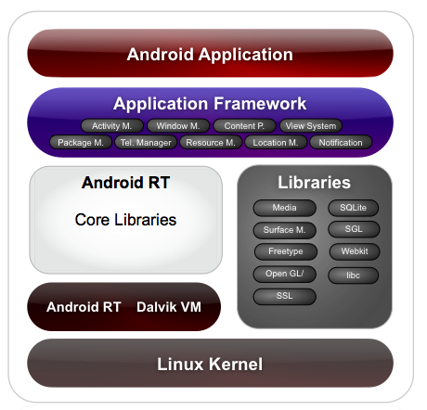
MAJOR COMPONENTS OF ANDROID OS

Slide 77
Android development
Java Source
Android Manifest
Generated Class
Java Compiler
.dex
File
Dalvik
VM
Resource XML
Android Libraries

Slide 78
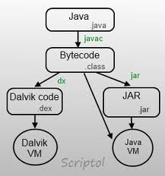
DVM
Dalvik is the process virtual machine (VM) in Google's Android operating system. It is the software that runs the apps on Android devices. Dalvik is thus an integral part of Android, which is typically used on mobile devices such as mobile phones and tablet computers as well as more recently on embedded devices such as smart TVs and media streamers. Programs are commonly written in Java and compiled to bytecode. They are then converted from Java Virtual Machine-compatible .class files to Dalvik-compatible .dex (Dalvik Executable) files before installation on a device. The compact Dalvik Executable format is designed to be suitable for systems that are constrained in terms of memory and processor speed.
From Wikipedia, the free encyclopedia

Slide 79
The Dex File Format
In standard Java environments, Java source code is compiled into Java bytecode, which is stored within .class files. The .class files are read by the JVM at runtime. Each class in your Java code will result in one .class file. This means that if you have, say, one .java source file that contains one public class, one static inner class, and three anonymous classes, the compilation process (javac) will output 5 .class files.
--On the Android platform, Java source code is still compiled into .class files. But after .class files are generated, the “dx” tool is used to convert the .class files into a .dex, or Dalvik Executable, file. Whereas a .class file contains only one class, a .dex file contains multiple classes. It is the .dex file that is executed on the Dalvik VM.
The .dex file has been optimized for memory usage and the design is primarily driven by sharing of data. The following diagram contrasts the .class file format used by the JVM with the .dex file format used by the Dalvik VM.4 5

Slide 80
Eclipse
I suggest, you keep one copy of Eclipse a side.
Well, you can always download, but to save time.
Incase if you screw up the settings, etc then you can always revert back to original clean copy.
Good news, no need to uninstall or install it though.

Slide 81
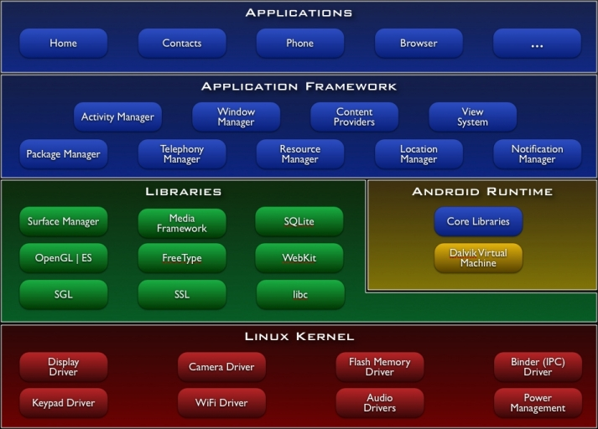

Slide 82
Linux Kernel
Works as a HAL
Device drivers
Memory management
Process management
Networking

Slide 83
Libraries
C/C++ libraries
Interface through Java
Surface manager – Handling UI Windows
2D and 3D graphics
Media codecs, SQLite, Browser engine

Slide 84
Android Runtime
Dalvik VM
  Dex files
  Compact and efficient than class files
  Limited memory and battery power
Core Libraries
  Java 5 Std edition
  Collections, I/O etc…

Slide 85
Application Framework
API interface
Activity manager – manages application life cycle.

Slide 86
Applications
Built in and user apps
Can replace built in apps

Slide 87
woh od I dela ihtw gubs
will not leave you alone since it is CT ☺
Always keep the second copy of working code somewhere else in backup before you screw it up.
Search for error on Google and on forums. You will find solution. You will learn a lot while searching. So Yeh, you need to have ____ to learn.
Always document all ____ fixes with yourself throughout your programming studies and career.
I documented some ____ over 6 months of work and I am including/publishing them in my book, coming in 2013.

Slide 88
Concepts
  activity,
  service,
  broadcast receiver,
  content provider,
  intent,
  AndroidManifest
  Slides 9-19 are from Professor Becker Hecker.

Slide 89
Applications
Written in Java (it’s possible to write native code – will not cover that here)
Good separation (and corresponding security) from other applications:
  Each application runs in its own process
  Each process has its own separate VM
  Each application is assigned a unique Linux user ID – by default files of that application are only visible to that application (can be explicitly exported)

Slide 90
Application Components
Activities – visual user interface focused on a single thing a user can do
Services – no visual interface – they run in the background
Broadcast Receivers – receive and react to broadcast announcements
Content Providers – allow data exchange between applications

Slide 91
Activities
Basic component of most applications
Most applications have several activities that start each other as needed
Each is implemented as a subclass of the base Activity class

Slide 92
Activities – The View
Each activity has a default window to draw in (although it may prompt for dialogs or notifications)
The content of the window is a view or a group of views (derived from View or ViewGroup)
Example of views: buttons, text fields, scroll bars, menu items, check boxes, etc.
View(Group) made visible via Activity.setContentView() method.

Slide 93
Services
Does not have a visual interface
Runs in the background indefinitely
Examples
  Network Downloads
  Playing Music
  TCP/UDP Server
You can bind to a an existing service and control its operation

Slide 94
Broadcast Receivers
Receive and react to broadcast announcements
Extend the class BroadcastReceiver
Examples of broadcasts:
  Low battery, power connected, shutdown, timezone changed, etc.
  Other applications can initiate broadcasts

Slide 95
Content Providers
Makes some of the application data available to other applications
It’s the only way to transfer data between applications in Android (no shared files, shared memory, pipes, etc.)
Extends the class ContentProvider;
Other applications use a ContentResolver object to access the data provided via a ContentProvider

Slide 96
Intents
An intent is an Intent object with a message content.
Activities, services and broadcast receivers are started by intents. ContentProviders are started by ContentResolvers:
  An activity is started by Context.startActivity(Intent intent) or Activity.startActivityForResult(Intent intent, int RequestCode)
  A service is started by Context.startService(Intent service)
  An application can initiate a broadcast by using an Intent in any of Context.sendBroadcast(Intent intent), Context.sendOrderedBroadcast(), and Context.sendStickyBroadcast()

Slide 97
Shutting down components
Activities
  Can terminate itself via finish();
  Can terminate other activities it started via finishActivity();
Services
  Can terminate via stopSelf(); or Context.stopService();
Content Providers
  Are only active when responding to ContentResolvers
Broadcast Receivers
  Are only active when responding to broadcasts

Slide 98
Android Manifest
Its main purpose in life is to declare the components to the system:
<?xml version="1.0" encoding="utf-8"?>
<manifest . . . >
<application . . . >
<activity android:name="com.example.project.FreneticActivity"
android:icon="@drawable/small_pic.png"
android:label="@string/freneticLabel"
. . . >
</activity>
. . .
</application>
</manifest>

Slide 99
Intent Filters
Declare Intents handled by the current application (in the AndroidManifest):
<?xml version="1.0" encoding="utf-8"?>
<manifest . . . >
<application . . . >
<activity android:name="com.example.project.FreneticActivity"
android:icon="@drawable/small_pic.png"
android:label="@string/freneticLabel"
. . . >
<intent-filter . . . >
<action android:name="android.intent.action.MAIN" />
<category android:name="android.intent.category.LAUNCHER" />
</intent-filter>
<intent-filter . . . >
<action android:name="com.example.project.BOUNCE" />
<data android:mimeType="image/jpeg" />
<category android:name="android.intent.category.DEFAULT" />
</intent-filter>
</activity>
. . .
</application>
</manifest>
Shows in the Launcher and is the main activity to start
Handles JPEG images in some way

Slide 100
GUI
Familiarize with the main types of GUI components
Concepts:
  Layouts
  Widgets
  Menus
  Slides from 31-36 are from Professor Becker Hecker.

Slide 101
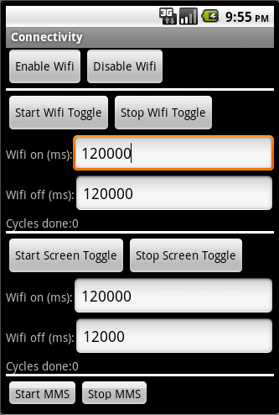
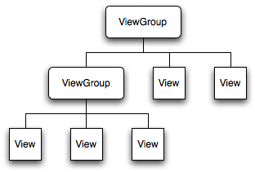
View Hierarchy
All the views in a window are arranged in a tree
You show the tree by calling setContentView(rootNode) in the activity

Slide 102
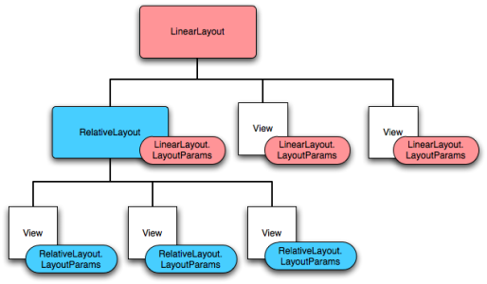
Layout
Defines how elements are positioned relative to each other (next to each other, under each other, in a table, grid, etc.)
Can have a different layouts for each ViewGroup

Slide 103
Widgets
All are View objects
Examples:
  TextFields
  EditFields
  Buttons
  Checkboxes
  RadioButtons
  etc.

Slide 104
UI Events
Usually handled by defining a Listener of the form On<something>Listener and register it with the View
For example:
  OnClickListener() for handling clicks on Buttons or Lists
  OnTouchListener() for handling touches
  OnKeyListerner() for handling key presses
Alternatively, Override an existing callback if we implemented our own class extending View

Slide 105
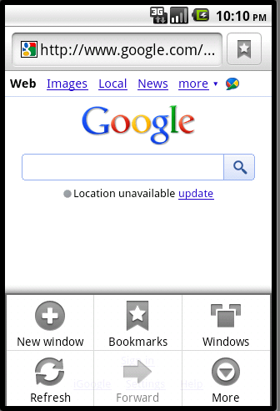
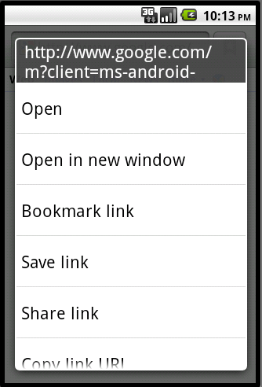
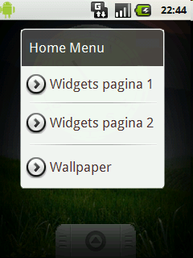
Menus
Options Menu
Context Menu
Sub-menu

Slide 106
Menus (continued)
MenuItem
Has 0 or more
MenuItem
Has 0 or more
Has 0 or more
SubMenu

Slide 107
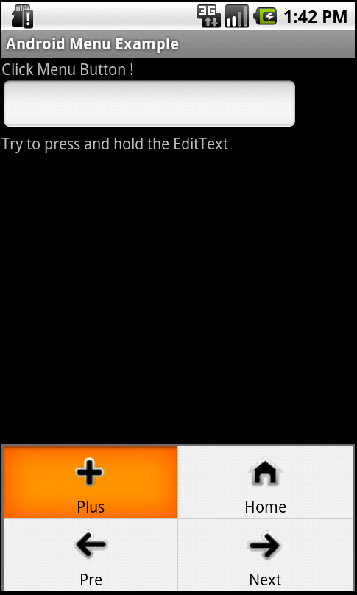
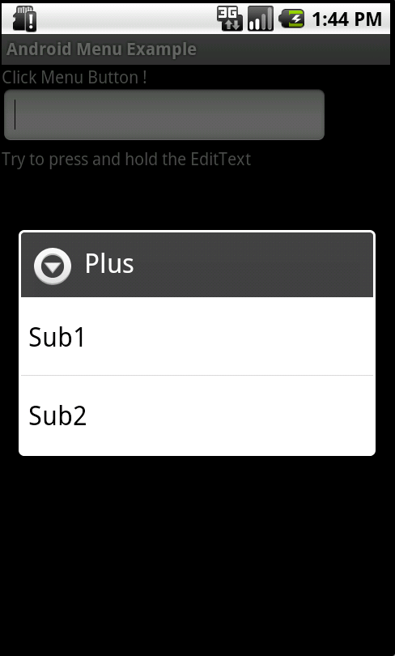
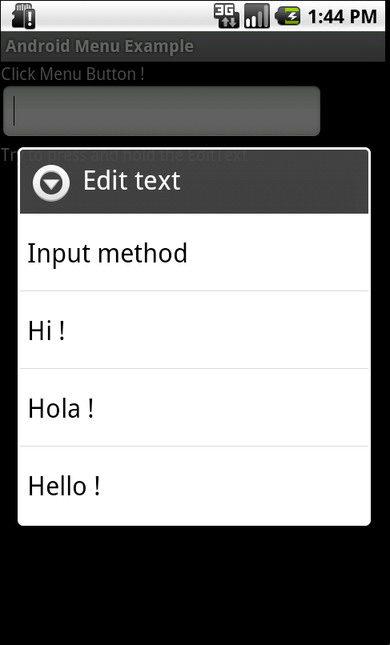
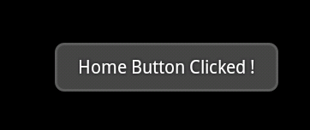
Goal
Create an application that supports options/sub/context menus
Display messages when
a menu clicked
Automatically
fill “Hi!”
in the EditText
Plus menu will
also open a
sub-menu
<option menu>
<sub-menu>
<context menu>

Slide 108
Menu Composition
Sub1
Hi
Plus
Hola
Sub2
Home
Hello
Long press
in EditText
<sub-menu>
Pre
Next
<option menu>
<context menu from EditText>

Slide 109
Question
Who owns Android ?

Slide 110
Answer
Google created the Android platform and it is (OSS) open source software so technically we all own it.

Slide 111
Do you know who you are?
Designer
Or
Developer

Slide 112
Here you go.
Designer makes things pretty
Developer make sure they work.

Slide 113
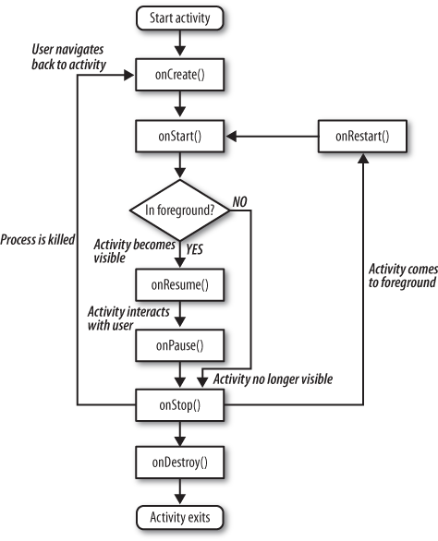
Android Program
Is nothing but a bunch of instances of objects from a framework.
It starts with activity.

Slide 114
onCreate
Called when your activity is first created. This is the place you normally create your views, open any persistent datafiles your activity needs to use, and in general initialize your activity. When calling onCreate, the Android framework is passed a Bundle object that contains any activity state saved from when the activity ran before.
onStart
Called just before your activity becomes visible on the screen. Once onStart completes, if your activity can become the foreground activity on the screen, control will transfer to onResume. If the activity cannot become the foreground activity for some reason, control transfers to the onStop method.
onResume
Called right after onStart if your activity is the foreground activity on the screen. At this point your activity is running and interacting with the user. You are receiving keyboard and touch inputs, and the screen is displaying your user interface. onResume is also called if your activity loses the foreground to another activity, and that activity eventually exits, popping your activity back to the foreground. This is where your activity would start (or resume) doing things that are needed to update the user interface (receiving location updates or running an animation, for example).
onPause
Called when Android is just about to resume a different activity, giving that activity the foreground. At this point your activity will no longer have access to the screen, so you should stop doing things that consume battery and CPU cycles unnecessarily. If you are running an animation, no one is going to be able to see it, so you might as well suspend it until you get the screen back. Your activity needs to take advantage of this method to store any state that you will need in case your activity gains the foreground again—and it is not guaranteed that your activity will resume. If the mobile device you are running on runs out of memory, there is no virtual memory on disk to use for expansion, so your activity may have to make way for a system process that needs memory. Once you exit this method, Android may kill your activity at any time without returning control to you.
onStop
Called when your activity is no longer visible, either because another activity has taken the foreground or because your activity is being destroyed.
onDestroy
The last chance for your activity to do any processing before it is destroyed. Normally you'd get to this point because the activity is done and the framework called its finish method. But as mentioned earlier, the method might be called because Android has decided it needs the resources your activity is consuming.
It is important to take advantage of these methods to provide the best user experience possible.

Slide 115
Wake up Guys. Lets do some coding
Lets start the eclipse
Lets take a look at few things including SDK Manager, AVD manager, install new software options, preferences, etc, etc.
Lets take a look at Android Emulator
Lets create one simple Hello Android Project
Lets understand the Project structure as we see in Eclipse.

Slide 116
2. Create an Android Project in Eclipse
File → New → Project
Select “Android Project”
Fill in Project details...

Slide 117
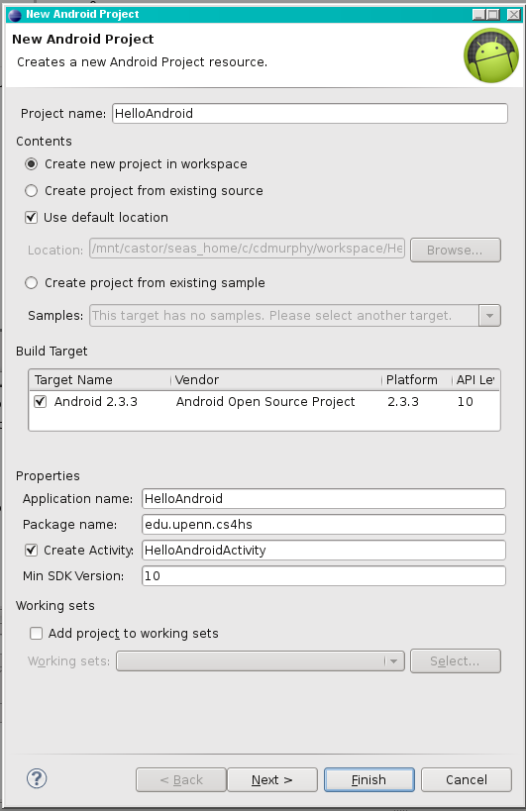
Directory
name
Android
version
Java package
Name that appears
on device
Class to
automatically
create

Slide 118
3. Run the Android Application
Run → Run (or click the “Run” button)
Select “Android Application”
The emulator may take a few minutes to start, so be patient!
You don't need to restart the emulator when you have a new version of your application

Slide 119
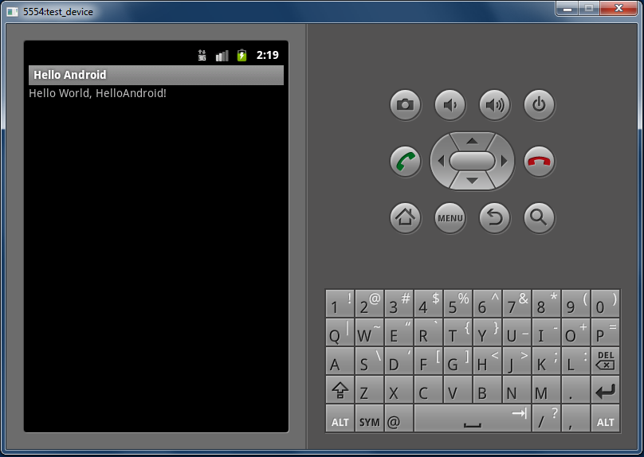

Slide 120
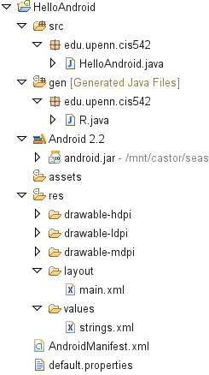
Source
code
Auto-generated
code
String
constants
UI
layout
Configuration

Slide 121
HelloAndroid.java
1 public class HelloAndroid extends Activity {
2 /** Called when the activity is first created. */
3 @Override
4 public void onCreate(Bundle savedInstanceState)
5 {
6 super.onCreate(savedInstanceState);
7 setContentView(R.layout.main);
8 }
9 }

Slide 122
main.xml
1 <?xml version="1.0" encoding="utf-8"?>
2 <LinearLayout
3 xmlns:android="http://schemas.android.com/apk/res/android"
4 android:orientation="vertical"
5 android:layout_width="fill_parent"
6 android:layout_height="fill_parent"
7 >
8 <TextView
9 android:layout_width="fill_parent"
10 android:layout_height="wrap_content"
11 android:text="@string/hello "
12 />
13 </LinearLayout>

Slide 123
strings.xml
1 <?xml version="1.0" encoding="utf-8"?>
2 <resources>
3 <string name="hello">Hello World, HelloAndroid!
4 </string>
5 <string name="app_name">Hello, Android</string>
6 </resources>

Slide 124
AndroidManifest.xml
1 <?xml version="1.0" encoding="utf-8"?>
2 <manifest
3 xmlns:android="http://schemas.android.com/apk/res/android"
4 package="edu.upenn.cis542"
5 android:versionCode="1"
6 android:versionName="1.0">
7 <application android:icon="@drawable/icon"
8 android:label="@string/app_name">
9 <activity android:name=".HelloAndroid"
10 android:label="@string/app_name">
11 <intent-filter>
12 <action
13 android:name="android.intent.action.MAIN" />
14 <category
15 android:name="android.intent.category.LAUNCHER"/>
16 </intent-filter>
17 </activity>
18 </application>
19 </manifest>

Slide 125
Lets dig into basic code(if you don’t mind)
public void onCreate(Bundle savedInstanceState) {
super.onCreate(savedInstanceState);
setContentView(R.layout.main);
The first thing to note is that onCreate receives an argument when it runs: a BUNDLE that will be referred to as savedInstanceState. Note also that the first thing onCreate does is call the onCreate method of its superclass. That makes sense because we want the chain of superclasses to initialize themselves appropriately. But what is this Bundle thing?
A Bundle is one of the mechanisms used by Android to pass structured data between Activities. It’s just a parcel of key/object pairs, and you’ll see later when we start another Activity that we have the option of passing that Activity a Bundle.
The very last line in this section of code sets our Content View. A view, describes how an application window appears and interacts with the user. So the setContentView call tells Android that we want to use the layout information in R.layout.main.java to lay out the screen for the Activity. the R.* resource files are generated by the Android SDK from your own XML resource files when you compile your application (as a result of selecting Run); in this case, the parameters come from our res/layout/main.xml file. Android “inflates” these parameters when layouts are created, using them to determine how the layout looks.

Slide 126
Main.xml
<RelativeLayout xmlns:android="http://schemas.android.com/apk/res/android"
android:orientation="vertical"
android:layout_width="fill_parent"
android:layout_height="fill_parent"
android:background="#ffc5d1d4"
>
First, we say that we are going to use a Relative Layout for this screen. Android offers a variety of Layout types, and though it’s beyond the scope of today’s lecture, you can even define your own Layout types. A Relative Layout says that we are going to define the positions of the different user interface elements by relating their positions to each other and to the overall screen. That may sound a little vague right now, but it will be clear when we go into some of the attributes in detail.
The first few lines of code define overall attributes for the screen layout:
android:orientation
This tells Android which way we want “gravity” to work in determining the screen layout.
android:layout_width and
android:layout_height
These tell Android that we want to make use of the whole screen; we aren’t trying to leave room for other Activities to be partially visible.

Slide 127
Exploring Various Layout Types
The most commonly used layout classes are:
FrameLayout – designed to display a stack of child View controls. Multiple view controls can be added to this layout. This can be used to show multiple controls within the same screen space.
LinearLayout – designed to display child View controls in a single row or column. This is a very handy layout method for creating forms.
RelativeLayout – designed to display child View controls in relation to each other. For instance, you can set a control to be positioned “above” or “below” or “to the left of” or “to the right of” another control, referred to by its unique identifier. You can also align child View controls relative to the parent edges.
TableLayout – designed to organize child View controls into rows and columns. Individual View controls are added within each row of the table using a TableRow layout View (which is basically a horizontally oriented LinearLayout) for each row of the table.
http://mobile.tutsplus.com/tutorials/android/android-layout/
http://www.learn-android.com/2010/01/05/android-layout-tutorial/2/

Slide 128
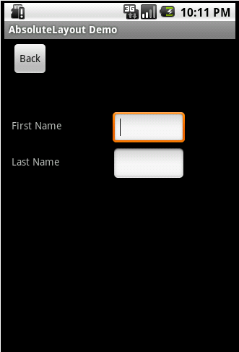
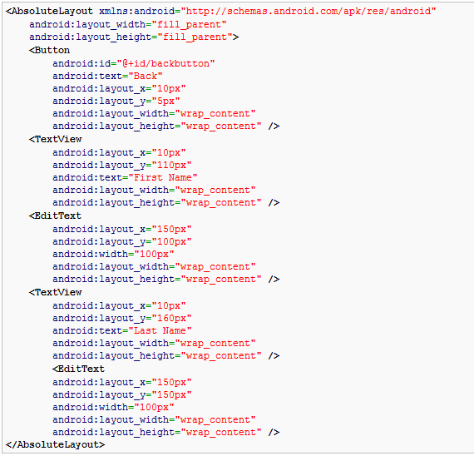
Note how each element has android:layout_x and android:layout_y specified. Android defines the top left of the screen as (0,0) so the layout_x value will move the control to the right, and the layout_y value will move the control down.

Slide 129
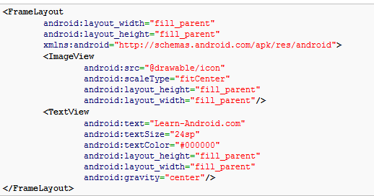
FrameLayout
FrameLayout is designed to display a single item at a time.
You can have multiple elements within a FrameLayout but each element will be positioned based on the top left of the screen. Elements that overlap will be displayed overlapping.

Slide 130
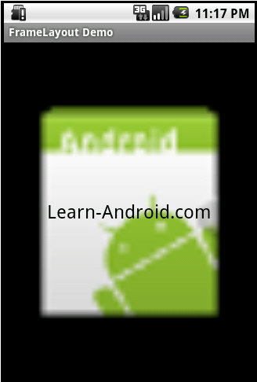
FrameLayout Continued !!!
ImageView and TextView fill the parent in both horizontal and vertical layout. Gravity specifies where the text appears within its container, so I set that to center. If I had not set a gravity then the text would have appeared at the top left of the screen.
FrameLayout can become more useful when elements are hidden and displayed programmatically. You can use the attribute android:visibility in the XML to hide specific elements. You can call setVisibility from the code to accomplish the same thing. The three available visibility values are visible, invisible (does not display, but still takes up space in the layout), and gone (does not display, and does not take space in the layout).
So you could, for example, have a game in a FrameView where text displayed to the user is visible in the middle of the screen at appropriate times (e.g. “Game Over”).

Slide 131
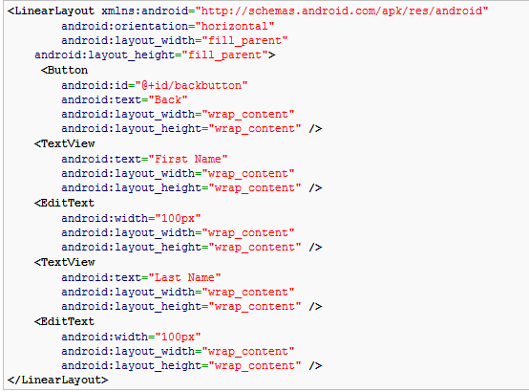
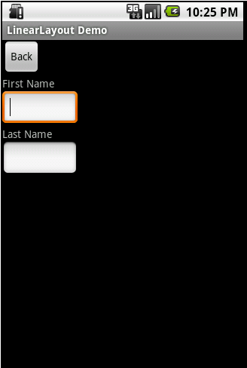
LinearLayout
LinearLayout organizes elements along a single line.
You specify whether that line is verticle or horizontal using android:orientation.
Here is a sample Layout XML using LinearLayout.

Slide 132
RelativeLayout
RelativeLayout
RelativeLayout lays out elements based on their relationships with one another, and with the parent container. This is arguably the most complicated layout, and we need several properties to actually get the layout we want.
Relative To Container
These properties will layout elements relative to the parent container.
android:layout_alignParentBottom – Places the bottom of the element on the bottom of the container
android:layout_alignParentLeft – Places the left of the element on the left side of the container
android:layout_alignParentRight – Places the right of the element on the right side of the container
android:layout_alignParentTop – Places the element at the top of the container
android:layout_centerHorizontal – Centers the element horizontally within its parent container
android:layout_centerInParent – Centers the element both horizontally and vertically within its container
android:layout_centerVertical – Centers the element vertically within its parent container

Slide 133
TableLayout
I let you figure this out.

Slide 134
Dimensions in Android
px (pixels)
If a dimension is set at 10px, it will be exactly 10 pixels long, no matter what the physical size (and physical density) of the pixels on the display. 10px will therefore be different sizes on handset displays with different pixel densities. On a QVGA display, for example (320×240 pixels), it will be 1/24th of the height of the display. The same 10px running on a VGA display (640×480 pixels) will be 1/64th of the height of the display.
dip or dp (device-independent pixels)
In an effort to make it easier to adapt applications to different pixel densities, dimensions can be expressed in device-independent pixels (sometimes also called “density-independent pixels”). When you specify a dimension of 10dpi, Android will scale the resulting object so it appears the same size it would appear on a 160dpi screen. For example, if a 640×480 display is 4"×3", its pixel density is 160 dots per inch (640/4, or 480/3). On that screen, dp’s are the same as px’s. But if we run the same application on a tablet-size VGA screen—say, 8"×6"—the pixel
density is 80dpi, and a dimension given as 10dp will be twice as large as a dimension given as 10px. The scaling factor for dp’s is approximate—Android doesn’t try to make dp’s come out exactly right.
sp (scaled pixels)
Scaled pixels are a lot like dp’s, but they are intended for elements that need finer control over the density scaling factor, such as text.
pts (points)
This is used to express text size in points, just as you would in any text editor. Points are a fixed dimension (roughly 1/72nd of an inch), so the text will appear the same size on any display.
in (inches)
This is just what it says: the dimension in inches.
mm (millimeters)
This is also just what it says, only metric this time.

Slide 135
Debugging Android Applications
The Tools
Throughout the development lifecycle of writing, building, and running the application, the primary tools Android developers use are:
Eclipse Java Editor
A specific text editor for Java that Android SDK has informed about the Android programming environment. The editor not only warns you about code the compiler can’t parse, but also gives you a wealth of information about what it can.
Java and Dalvik Build System
Recall that Android converts your Java application to run on the Dalvik virtual machine under Android. The Java compiler and the Dalvik translator both provide error information if they can’t build your application.
Eclipse Debugger
Eclipse provides a source-level debugger that the Android SDK connects with the running Dalvik bytecode, so you have all the debug capability you’d normally expect from a Java program running under Eclipse.
Logcat
Android also provides a general-purpose logging package that you can take advantage of to log informational or error messages from your running application. Perhaps of more importance, Android uses this facility extensively to tell you what is going on as it starts up, initiates your application, and tries to run it. There is also a special logcat log for telephony-related messages.
Android Debug Bridge (adb)
This provides a command-line debugging interface to a running Android phone or emulator.
DDMS
Android also provides a special window-oriented debugging environment custom tailored for Android and the Dalvik VM.
Traceview
An Android-specific utility that tracks all the method calls your application executed and the time spent in each method.

Slide 136
Signing and Publishing
Your Application
Listen, Not that quick.
In future lectures.
You just came out of your diapers and you want to join Olympics this year. ☺

Slide 137
Using real android device

Slide 138
Hardware devices with android application
Your main resource: http://developer.android.com/tools/device.html
Declare your application as "debuggable" in your Android Manifest. When using Eclipse, you can skip this step, because running your app directly from the Eclipse IDE automatically enables debugging.
In the AndroidManifest.xml file, add android:debuggable="true" to the <application> element.
Note: If you manually enable debugging in the manifest file, be sure to disable it before you build for release (your published application should usually not be debuggable).
Turn on "USB Debugging" on your device. On the device, go to Settings > Applications > Development and enable USB debugging (on an Android 4.0 device, the setting is located in Settings > Developer options).
Notes:
Note: When developing on a device, keep in mind that you should still use the Android emulator to test your application on configurations that are not equivalent to those of your real device. Although the emulator does not allow you to test every device feature (such as the accelerometer), it does allow you to verify that your application functions properly on different versions of the Android platform, in different screen sizes and orientations, and more.

Slide 139
Continued !!!!!
Set up your system to detect your device.
  If you're developing on Windows, you need to install a USB driver for adb. For an installation guide and links to OEM drivers, see the OEM USB Drivers document.
  If you're developing on Mac OS X, it just works. Skip this step.
  If you're developing on Ubuntu Linux, you need to add a udev rules file that contains a USB configuration for each type of device you want to use for development. In the rules file, each device manufacturer is identified by a unique vendor ID, as specified by the ATTR{idVendor} property. For a list of vendor IDs, see USB Vendor IDs, below. To set up device detection on Ubuntu Linux:
    Log in as root and create this file: /etc/udev/rules.d/51-android.rules. Use this format to add each vendor to the file:
    SUBSYSTEM=="usb", ATTR{idVendor}=="0bb4", MODE="0666", GROUP="plugdev"
    In this example, the vendor ID is for HTC. The MODE assignment specifies read/write permissions, and GROUP defines which Unix group owns the device node.
    Note: The rule syntax may vary slightly depending on your environment. Consult the udev documentation for your system as needed. For an overview of rule syntax, see this guide to writing udev rules.
    Now execute:
    chmod a+r /etc/udev/rules.d/51-android.rules
When plugged in over USB, can verify that your device is connected by executing adb devices from your SDK platform-tools/ directory. If connected, you'll see the device name listed as a "device."
If using Eclipse, run or debug your application as usual. You will be presented with a Device Chooser dialog that lists the available emulator(s) and connected device(s). Select the device upon which you want to install and run the application.

Slide 140
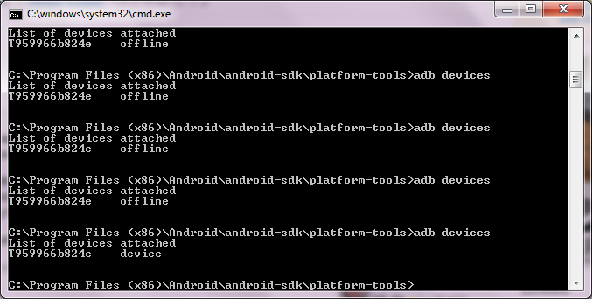
That is how you can verify

Slide 141
Use forums
http://stackoverflow.com/questions/7817044/how-to-create-an-avd-for-android-4-0

Slide 142
I want you to read this article.
http://www.androidguys.com/2010/05/07/android-apis-spectrum-openness/
http://developer.android.com/reference/android/view/View.OnClickListener.html

Slide 143
Read these too.
http://mmcneil.com/2012/01/who-really-invented-the-smartphone/
http://www.petesqbsite.com/sections/express/issue17/modularversusoop.html
http://onlamp.com/onlamp/2005/09/15/what-is-opensource.html
http://androidapps.org.ua/androidintro_ipc_intent.html

Slide 144
In Essence
You can not remember Everything.
You must consult documentation every time.
With time, you will be able to tell and type from your head.
Even I consult documentation each time.
Why to remember if documentation is freely available and made for us.
We just have to learn how to use them.
http://developer.android.com

Slide 145
Believe me or not
I got 5 emails few weeks ago in regard to .NET Developer Jobs
2 of them were with Mobile Development as well.
In this tough economy – They are hiring.
Good news for you
Can I get dinner treat tonight from all of you for such a great news?

Slide 146
So What You need to do when you miss me so bad until we meet next time
Stick to http://developer.android.com
Write Just one Program every Sunday.
Introduce some bugs into it.
Search for Bugs.
Find all alternative solutions.
Understand them and document them.
Reading, Reading, Reading Documentation about Frameworks, APIs, etc.
Write one Chapter of Your OWN. Call it “My First Experience with Android in 2012”.

Slide 147
Your home work on Christmas eve
http://developer.android.com is your website from today.
Read, Read, Read, API documentation.
If haven’t worked in Java, Give little respect to it as well. Get help from Oracle Docs.
Play around with eclipse.
Look into Job Market and Economy and envision how does future of OS looks like and then be creative to develop such apps for businesses to make some money ☺
Then Once you realize that you want to learn Android, then start Bugging Dr. Lyon day and night to introduce this course ☺

Slide 148
Acknowledgements
Thanks to Dr. Douglas Lyon for providing me with an opportunity to deliver today’s lecture
Thanks to Professor Barbara Hecker, PhD
Thanks to Chris Murphy
cdmurphy@cis.upenn.edu

Slide 149

NO Difficult Questions, Please ☺
Since no all questions can be answered, or scientist would have answered why water in Lake Hillier in Western Australia is pink?

